Slide 1

The Social Acceptance of Wind Energy in Austria and the Czech Republic
Rostislav Moric
Martin Schoenberg

Slide 2
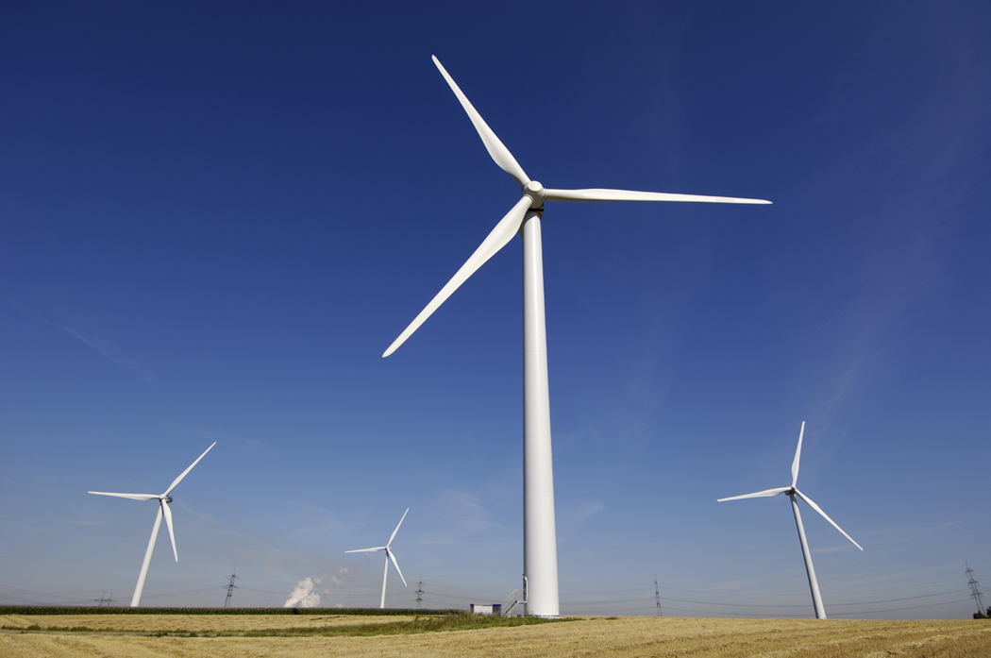
Content
Motivation
Methodology
Results:
  Wind Energy in Austria
  Wind Energy in the Czech Republic
  Survey
  A Comparison of both Countries
Conclusion

Slide 3
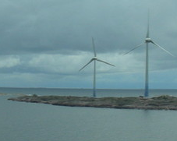
Introduction - Motivation
Wind Power: a clean and safe form of renewable energy
huge on- and offshore wind parks
Wind Energy in Central Europe
Importance of the acceptance of residents, stakeholders or the local community
In Austria far more wind power plants than in the Czech Republic although both countries have a very similar wind energy potential
→ Question: different attitudes and preferences regarding wind energy do exist (or not)
→ Aim: to present the current situation of the acceptance of wind energy in both countries and to derive recommendations that can be useful for the energy sector and for planners of actor-centered participation processes

Slide 4
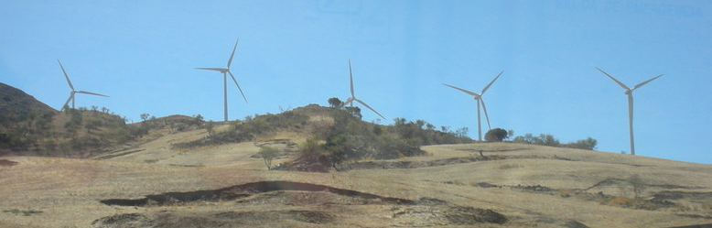
Methodology
different studies were scrutinized
a on-line questionnaire was set up
  ‘Triangle Model of Social Acceptance’ that includes socio-political acceptance, community acceptance and market acceptance
Detection of possible predominant attitudes in one country, leading to a comparison of the results of the survey and of the literature research as well

Slide 5
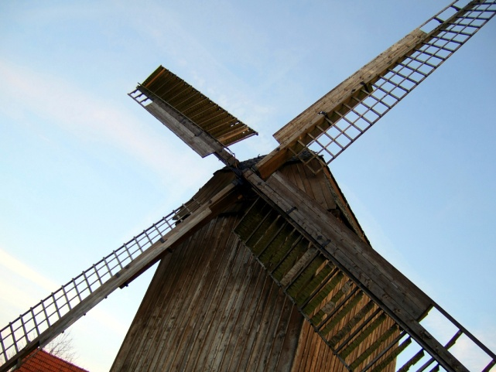
Results:Wind Energy in Austria I
656 wind driven power stations
with a maximum capacity of 1.084 MW
2011: erection of 31 new plants
with a capacity of 73 MW
First actor–centered analytical approach in the 1990s:
“The successful realisation of a wind power project depends, ..., above all on the interaction between the actors involved and on the decision process on a local level” (Forschungsforum I, 1999)
2003: survey of the Gallup institute: which means of electricity production Austrians like most and which energy sources should be promoted

Slide 6
Results:Wind Energy in Austria II
Most of the wind power stations are concentrated in the north-eastern parts of Austria:
  Natural/environmental preconditions: sea level, climatic factors, such as average wind speed, population, industry density play a decisive role
  attitudes and preferences of the local population (that can be linked to ecological criteria as well) influence and determine a successful implementation of a wind energy project
→the main arguments are not always based on “efficacy and economy” but often refer to crowded landscapes, wildlife (birds and bats), turbine proximity to residences, health, safety, nuisance and annoyance (Lantz, 2011)

Slide 7
Results:Wind Energy in Austria III
Strong resistance:
  in the case that a power station is planned near or within a natural reserve (a case in point is the Naturpark Dobratsch near Villach)
  various elements of social acceptance being affected: well-being, policy and strategies, procedural design, distributional justice and implementation strategies.
→social acceptance performs as a barrier to the erection of wind driven power stations in Austria because new impacts on a landscape have appeared: -low energy density
- a moving element that constitutes a new industrial infrastructure in rustic rural locations.

Slide 8
Results:Wind Energy in the Czech Republic
HISTORY
1277 – first wind mill built
→ 879 wind mills
beginning of 20th century - first wind power plant
2 phases
  1990 – 1995: 25 wind power plants built
  lack of fundamental legislation+technological knowlidge → progress stopped
  from 2001: appraised electric energy by Czech Energy Regulatory Office

Slide 9
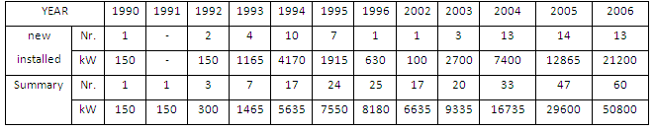
Results:Wind Energy in the Czech Republic
Development of wind energy in the Czech Republic 1990 – 2006

Slide 10
Survey: Questionnaire #1
1. Are you interested in renewable energy?
2. Renewable energy sources can be categorised into wind, solar, water, biomass and geothermal ones. Line up these energy sources according to their impact on the environment, starting with the source with the highest negative environmental impact
3. How is your attitude towards building windmills (wind-driven power stations)?
4. Would you agree with building windmills that are just 2 km far from your home? *
5. [If 4 = No] Would you change your mind, if you had any benefits from the construction of the windmill?

Slide 11
Survey: Questionnaire #2
6. According to you, what are the biggest advantages of windmills? *
(ecological operation, low running costs, decrease dependence on fossil materials, investment, development of place, I don't see any advantage)
7. On the other hand, what are the disadvantages? *
(influence on the local environment, low yearly profit, noise, uncertainty of energy delivery)
8. Do you think that the public in your country is well informed about wind energy in general? *
9. Have you ever seen a windmill in service? *

Slide 12
Survey: Results #1
interested in favour of wind energy as a clean and safe form of alternative energy
72 % interested in renewable energy
Lining up renewable energy by negative impact (highest→smallest)
  biomass-water-wind-solar-geothermal
88 % agree or rather agree with wind energy
45 % agree with building wind power plant 2 km from their home
  68 % of deniers change their minds for benefits

Slide 13
Survey: Results #
Advanteges/Disadvanteges of wind power plant
75 % is not well informed
94 % have seen wind mill in operation
Ecological operation | Influence on local environment
Low running costs | Low yearly profit
↓dependence on fossil fuels | Noise
Investment | Uncertainty of energy delivery
Developmnet of place
I don‘t see any (2)

Slide 14
A Comparison of both Countries I
both countries interested in and in favour of wind energy as a clean and safe form of alternative energy
acceptance of renewable energies and especially of wind energy is not the same across Europe:
Differences:
  financial support for households and SMEs is the first priority
  wind energy among the three energy sources most likely to be used

Slide 15
A Comparison of both Countries II
Possible explanation:
  a different historical-political context
  In various approaches the so-called ‘level of trust’ was investigated.:
    A lower level of trust in post-Soviet civil societies could constitute an obstacle for the realization of new energy projects.
“Getting all the pieces to fit together is made all the more difficult in new member states because of the lack of understanding and mistrust that exists among decision-makers, technical experts, and citizens. Various studies have demonstrated the low level of trust in post-Soviet civil societies,... .” (Heinrich-Böll-Stiftung Brandenburg e.V., 2011)

Slide 16
Conclusion
Different attitudes of Austrians and Czechs towards renewable energies – in specific towards wind energy – do exist due to a different social and historical-political context
We suggest that further analysis have to be carried out on a regional and local level
Wind Energy in Central Europe is region and community-centered:
  wind power stations are not distributed the same across one country or specific area although the same wind speed and various other similar (geomorphologic) preconditions are existent (Without assuming that the density of distribution of power stations is just a function of social acceptance)

Slide 17
Literature
ČSVE (2009). Česká společnost pro větrnou energii: Z historie využívání energie větru v českých zemích [online]. Available from: http://www.csve.cz/clanky/detail/36 [Accessed 10 April 2012]
Dobesch, H./Kury, G (1997). Central European Wind Atlas, Figure A.7
European Commission (2008). Attitudes of European citizens towards the environment, Fieldwork: November – December 2007, Special Eurobarometer 295/ Wave 68.2 – TNS Opinion & Social
European Commission (2012). PUBLIC OPINION IN THE EUROPEAN UNION, Fieldwork: November 2011, Standard Eurobarometer 76 / Autumn 2011– TNS Opinion & Social [online]. Available from: http://ec.europa.eu/public_opinion/archives/eb/eb76/eb76_eu20_en.pdf [Accessed 22 April 2012]
EWEA (2009). Wind Energy – The Facts, A guide to technology, economics, and future of wind power. European Wind Energy Association. Social Acceptance of Wind Energy and Wind Farms, p.399 -407
EWEA (2012). Wind in power, 2011 European statistics. European Wind Energy Association [online]. Available from: http://www.ewea.org/fileadmin/ewea_documents/documents/publications/statistics/Stats_2011.pdf [Accessed 22 April 2012]
Forschungsforum I (1999). Social Acceptance of Wind Power in Austria, An Analysis of the Social Processes involved in the Installation of Wind Power Plants. [online]. Available from: http://www.socialacceptance.ch/Files/150_akzeptanz_wind_%C3%B6sterreich_en.pdf [Accessed 13 April 2012]
Forschungsforum II (1997). Wind Power in Austria - Analysis of strategies and problems [online]. Available from: http://www.nachhaltigwirtschaften.at/publikationen/forschungsforum/991/teil1.en.html [Accessed 13 April 2012]
Heinrich-Böll-Stiftung Brandenburg e.V. (2011). Participation in Urban Climate Protection. Answers of European Municipalities [online]. Available from: http://participation.blogsport.de/images/SustainableEnergyDevelopmentandSocialAcceptance.pdf[Accessed 13 April 2012]
IEA Wind Task 28 (2010). Social Acceptance of Wind Energy, State-of-the-Art Report, Stefanie Huber, Robert Horbaty, ENCO AG, Switzerland
IG Windkraft (2012). Windenergie in Österreich [online]. Available from: http://igwindkraft.at/index.php?xmlval_ID_KEY[0]=1047 [Accessed 22 April 2012]
KUBÍN, Jiří/KONEČNÁ, Eva (2008). Obnovitelné zdroje elektrické energie a jejich využití v oblasti Libereckého kraje, Liberec, Fakulta mechatroniky a mezioborových inženýrských studií 2008, 43 pages, ISBN 978-80-7372-308-8
Lantz, Eric (2011). Social Acceptance of Wind Energy Projects “Winning Hearts and Minds”, Task 28 within IEA RD&D Wind, IEA Wind side event at EWEA 2011, March 16th 2011, NREL [online]. Available from: http://www.ewec2011.info/fileadmin/ewec2011_files/documents/Workshops/IEAWind/IEAWIND_Side_Event_EWEA2011_Acceptance_Eric_Lantz.pdf[Accessed 13 April 2012]
ŠTĚKL, Josef (2006). Větrná energetika na území ČR a u sousedů, Alternativní energie č. 6, 2006, p. 4 - 5
Wind Directions (2003). A summary of Opinion Surveys on Wind Power, Wind focus, in: WIND DIRECTIONS, Bimonthly Magazine, September/October 2003, p. 16-33
Wind Energy the Facts I (2012).The Social Acceptance of Wind Energy and Wind Farms [online]. Available from: http://www.wind-energy-the-facts.org/en/environment/chapter-6-social-acceptance-of-wind-energy-and-wind-farms/ [Accessed 13 April 2012]
Wind Energy the Facts II (2012).Social Research on Wind Energy Onshore [online]. Available from:http://www.wind-energy-the-facts.org/en/environment/chapter-6-social-acceptance-of-wind-energy-and-wind-farms/social-research-on-wind-energy-onshore.html[Accessed 13 April 2012]
Wüstenhagen,Rolf/ Wolsink,Maarten/ Bürer, Mary Jean (2007). Social acceptance of renewable energy innovation: An introduction to the concept, in Energy Policy, Volume: 35, Issue: 5, Publisher: Elsevier, Pages: 2683-2691
Zelená úsporám (2009). About The Green Savings programme [online]. Available from: http://www.zelenausporam.cz/sekce/582/about-the-green-savings-programme/ [Accessed 21 April 2012]

Slide 18
Thank you for your attention!

